Slide 1


INTRODUCTION
Company Name:
NEXTHIKES IT SOLUTIONS
Project Name:
MOBILE PRICE PREDICTION USING ML
Presented By:
PREYANSHI PANCHOLI

Slide 2
Project OBJECTIVE
✅ Objective: Predict the price of mobile phones using specifications such as RAM, memory, camera, battery, processor, etc.
🎯 Key Highlights:
Real-world dataset (Processed_Flipdata.csv) from an e-commerce context.
Preprocessing includes cleaning, encoding, and scaling.
✨ Uniqueness:
Uses real consumer product features.
Integrates both classical ML and XGBoost.
Focus on practical feature influence interpretation.

Slide 3
Libraries and GUI
• SCIKIT LEARN– Preprocessing, modeling, metrics
3
• SEABORN, MATPLOTLIB – Visualization.
XGBOOST – Advanced regression modeling.
2
• PANDAS, NUMPY:
Data Manupulation
1

Slide 4
✅ Solution: String cleaning + median imputation.
🧩 Challenge 2: Mixed data types (categorical + numerical). ✅ Solution: Used ColumnTransformer to separately process each.
🧩 Challenge 3: Model selection and evaluation. ✅ Solution: Compared 3 models:
Linear Regression
Gradient Boosting
XGBoost XGBoost performed best.
CHALLENGES AND SOLUTIONS

Slide 5
References
📚 Data Source:
Custom processed dataset Processed_Flipdata.csv (e-commerce specs)
🔗 Libraries Used:
Pandas Documentation
Scikit-learn Documentation
XGBoost
Matplotlib
Seaborn
📈 ML Concepts:
Regression, RMSE, MAE, Feature Importance, Pipelines

Slide 6
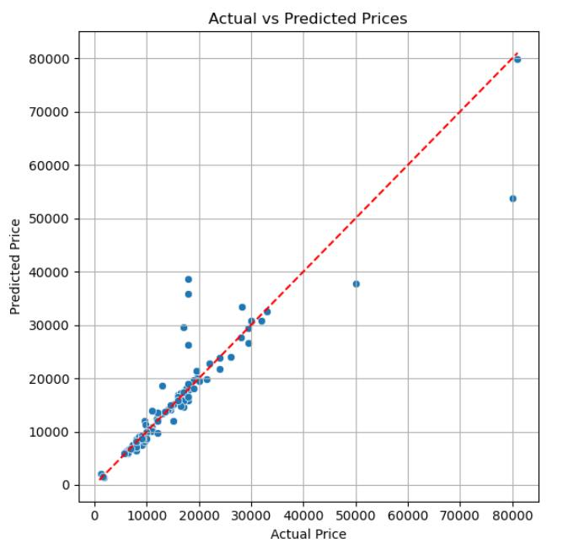
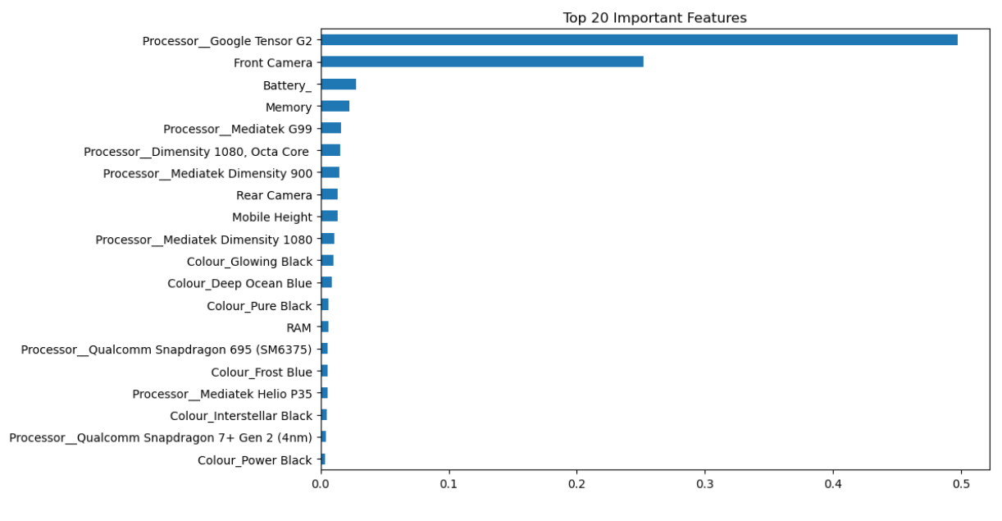

Slide 7
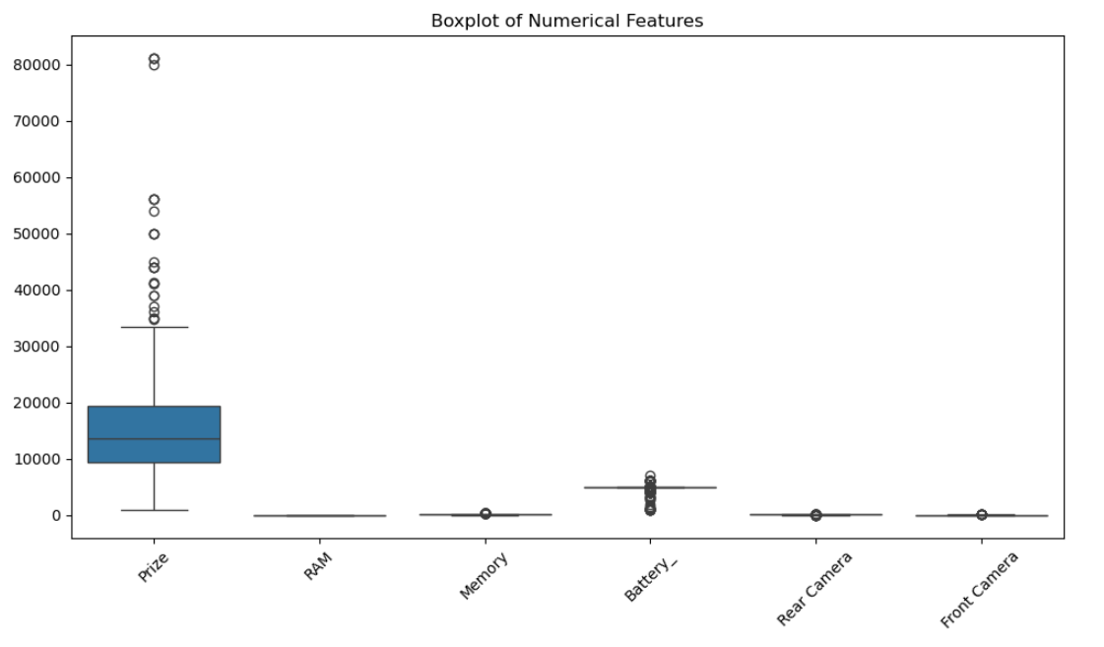
Thank You
Thank you for your attention!

